Slide 1

Chapter 13
Digital Signature
Copyright © The McGraw-Hill Companies, Inc. Permission required for reproduction or display.
13.<number>

Slide 2
Chapter 13
Objectives
To define a digital signature
To define security services provided by a digital
signature
To define attacks on digital signatures
To discuss some digital signature schemes, including
RSA, ElGamal,
Schnorr, DSS, and elliptic curve
To describe some applications of digital signatures
13.<number>

Slide 3
13-1 COMPARISON
Let us begin by looking at the differences between conventional signatures and digital signatures.
Topics discussed in this section:
13.1.1 Inclusion
13.1.2 Verification Method 390
13.1.3 Relationship
13.1.4 Duplicity
13.<number>

Slide 4
13.1.1 Inclusion
A conventional signature is included in the document; it is part of the document. But when we sign a document digitally, we send the signature as a separate document.
13.<number>

Slide 5
13.1.2 Verification Method
For a conventional signature, when the recipient receives a document, she compares the signature on the document with the signature on file. For a digital signature, the recipient receives the message and the signature. The recipient needs to apply a verification technique to the combination of the message and the signature to verify the authenticity.
13.<number>

Slide 6
13.1.3 Relationship
For a conventional signature, there is normally a one-to-many relationship between a signature and documents. For a digital signature, there is a one-to-one relationship between a signature and a message.
13.<number>

Slide 7
13.1.4 Duplicity
In conventional signature, a copy of the signed document can be distinguished from the original one on file. In digital signature, there is no such distinction unless there is a factor of time on the document.
13.<number>

Slide 8
13-2 PROCESS
Figure 13.1 shows the digital signature process. The sender uses a signing algorithm to sign the message. The message and the signature are sent to the receiver. The receiver receives the message and the signature and applies the verifying algorithm to the combination. If the result is true, the message is accepted; otherwise, it is rejected.
Topics discussed in this section:
13.2.1 Need for Keys
13.2.2 Signing the Digest
13.<number>

Slide 9
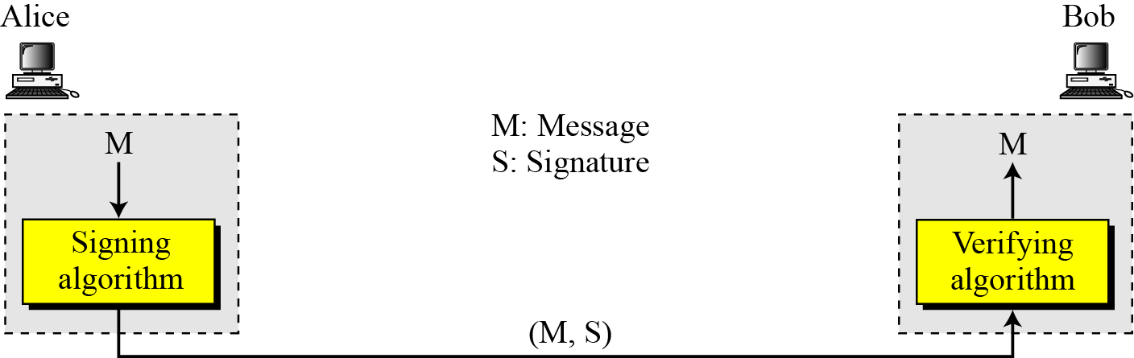
13-2 Continued
Figure 13.1 Digital signature process
13.<number>

Slide 10
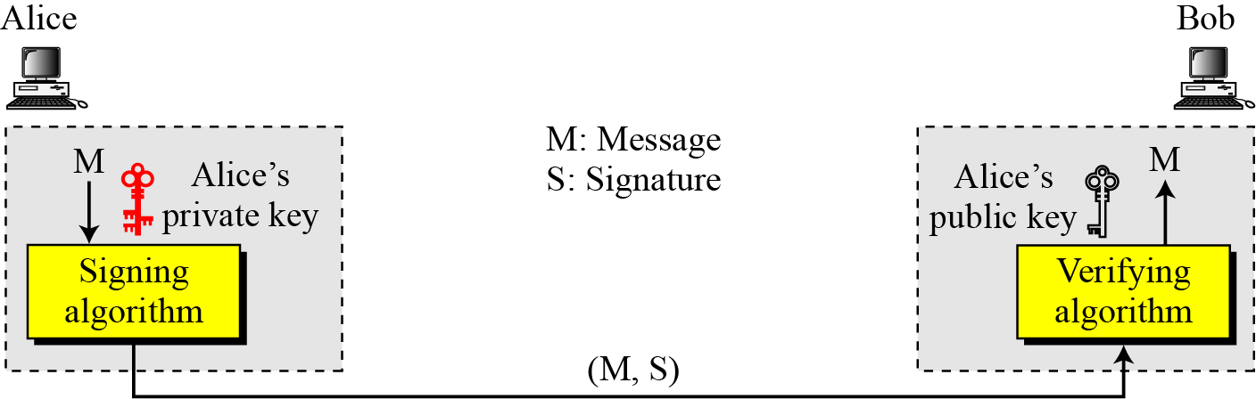

13.2.1 Need for Keys
Figure 13.2 Adding key to the digital signature process
Note
A digital signature needs a public-key system.
The signer signs with her private key; the verifier verifies with the signer’s public key.
13.<number>

Slide 11
13.2.1 Continued
Note
A cryptosystem uses the private and public keys of the receiver: a digital signature uses
the private and public keys of the sender.
13.<number>

Slide 12
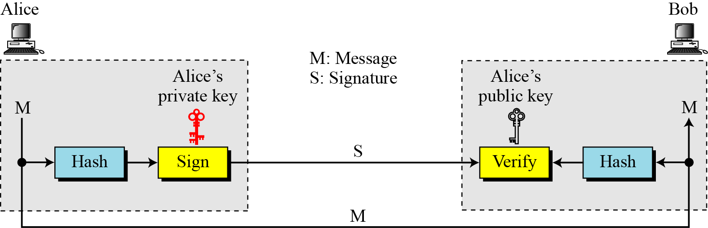
13.2.2 Signing the Digest
Figure 13.3 Signing the digest
13.<number>

Slide 13
13-3 SERVICES
We discussed several security services in Chapter 1 including message confidentiality, message authentication, message integrity, and nonrepudiation. A digital signature can directly provide the last three; for message confidentiality we still need encryption/decryption.
Topics discussed in this section:
13.3.1 Message Authentication
13.3.2 Message Integrity
13.3.3 Nonrepudiation
13.3.4 Confidentiality
13.<number>

Slide 14
13.3.1 Message Authentication
A secure digital signature scheme, like a secure conventional signature can provide message authentication.
Note
A digital signature provides message authentication.
13.<number>

Slide 15
13.3.2 Message Integrity
The integrity of the message is preserved even if we sign the whole message because we cannot get the same signature if the message is changed.
Note
A digital signature provides message integrity.
13.<number>

Slide 16
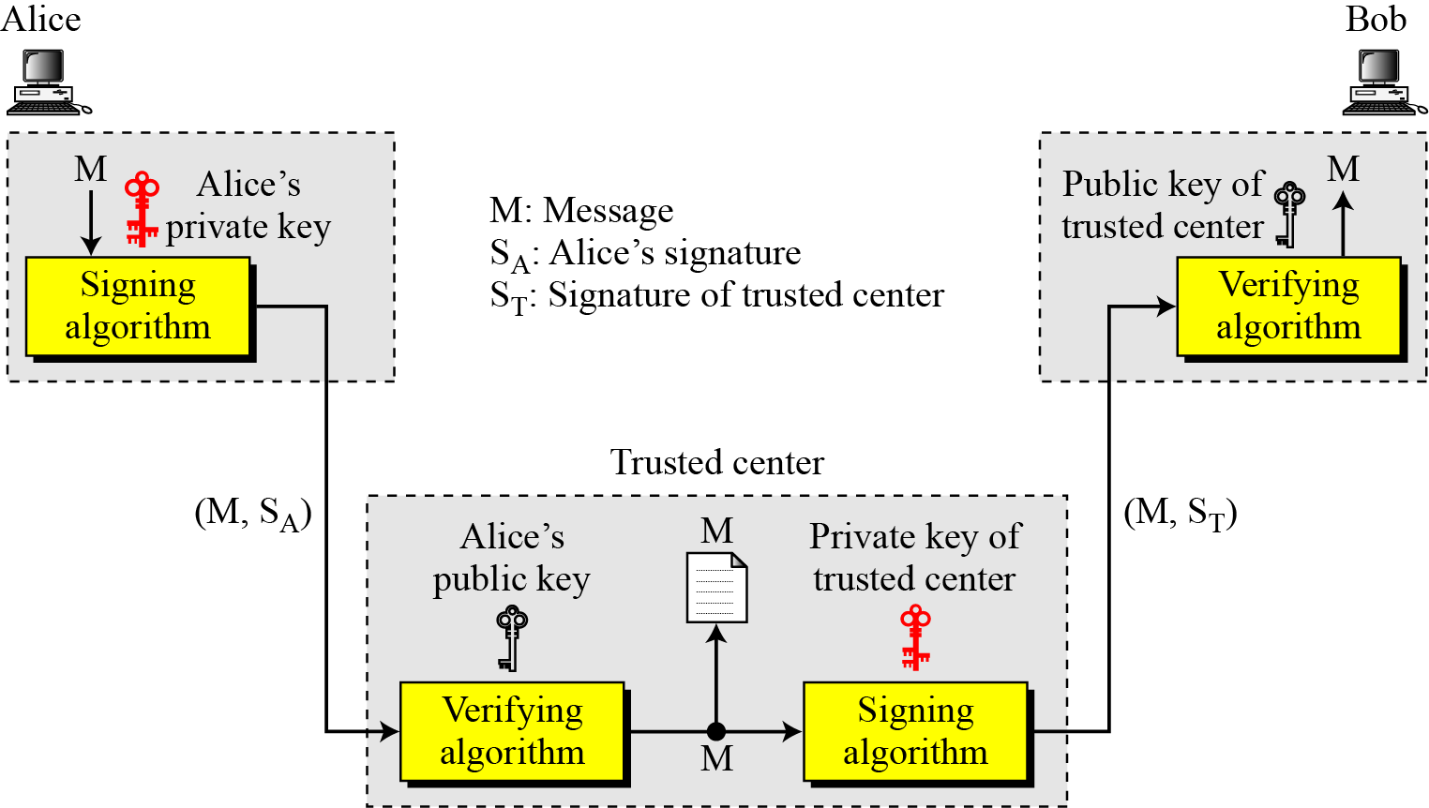
13.3.3 Nonrepudiation
Figure 13.4 Using a trusted center for nonrepudiation
Note
Nonrepudiation can be provided using a trusted party.
13.<number>

Slide 17
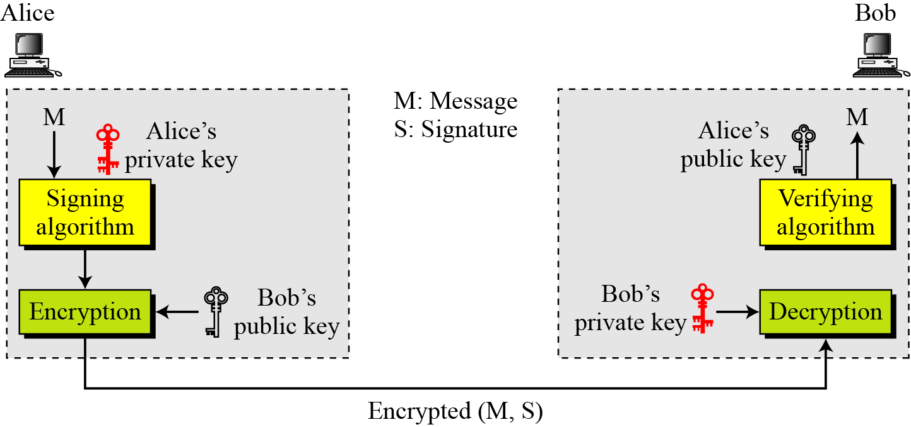
13.3.4 Confidentiality
Figure 13.5 Adding confidentiality to a digital signature scheme
Note
A digital signature does not provide privacy.
If there is a need for privacy, another layer of encryption/decryption must be applied.
13.<number>

Slide 18
13-4 ATTACKS ON DIGITAL SIGNATURE
This section describes some attacks on digital signatures and defines the types of forgery.
Topics discussed in this section:
13.4.1 Attack Types
13.4.2 Forgery Types
13.<number>

Slide 19
13.4.1 Attack Types
Key-Only Attack
the attacker is only given the public verification key.
Known-Message Attack
the attacker is given valid signatures for a variety of messages known by the attacker but not chosen by the attacker.
Chosen-Message Attack
the attacker first learns signatures on arbitrary messages of the attacker's choice.
13.<number>

Slide 20
13.4.2 Forgery Types
Existential Forgery
Existential forgery is the creation (by an adversary) of any message/signature pair (m,σ), where σ was not produced by the legitimate signer.
Selective Forgery
Selective forgery is the creation (by an adversary) of a message/signature pair (m,σ) where m has been chosen by the adversary prior to the attack.
13.<number>

Slide 21
13-5 DIGITAL SIGNATURE SCHEMES
Several digital signature schemes have evolved during the last few decades. Some of them have been implemented.
Topics discussed in this section:
13.5.1 RSA Digital Signature Scheme
13.5.2 ElGamal Digital Signature Scheme
13.5.3 Schnorr Digital Signature Scheme
13.5.4 Digital Signature Standard (DSS)
13.5.5 Elliptic Curve Digital Signature Scheme
13.<number>

Slide 22
13.5.1 Continued
Key Generation
Key generation in the RSA digital signature scheme is exactly the same as key generation in the RSA
Note
In the RSA digital signature scheme, d is private;
e and n are public.
13.<number>

Slide 23
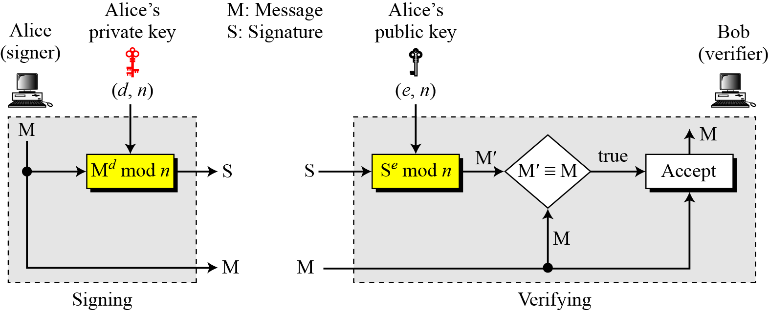
13.5.1 Continued
Signing and Verifying
Figure 13.7 RSA digital signature scheme
13.<number>

Slide 24
13.5.1 Continued
Example 13.1
As a trivial example, suppose that Alice chooses p = 823 and q = 953, and calculates n = 784319. The value of φ(n) is 782544. Now she chooses e = 313 and calculates d = 160009. At this point key generation is complete. Now imagine that Alice wants to send a message with the value of M = 19070 to Bob. She uses her private exponent, 160009, to sign the message:
Alice sends the message and the signature to Bob. Bob receives the message and the signature. He calculates
Bob accepts the message because he has verified Alice’s signature.
13.<number>

Slide 25
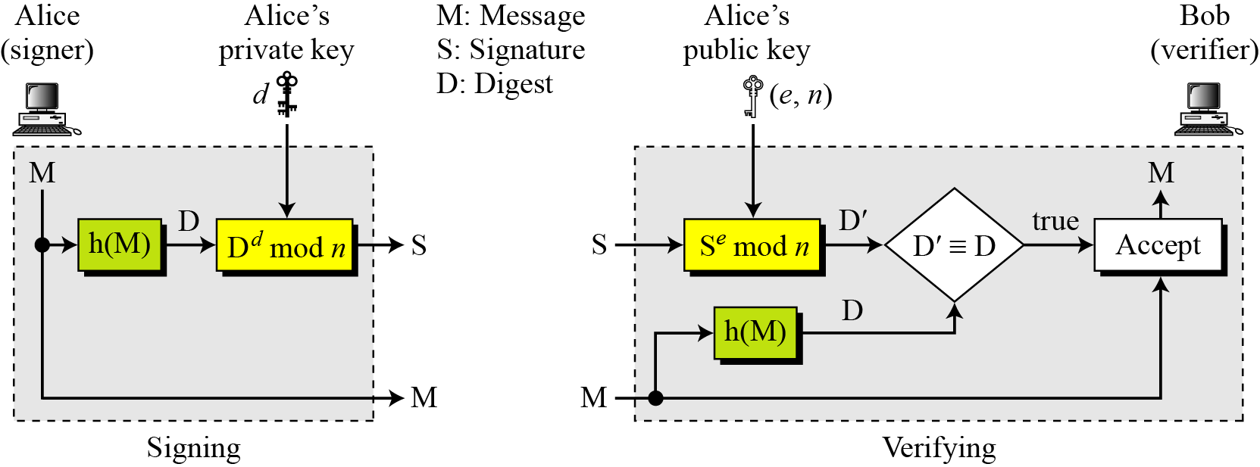
13.5.1 Continued
RSA Signature on the Message Digest
Figure 13.8 The RSA signature on the message digest
13.<number>

Slide 26
13.5.1 Continued
Note
When the digest is signed instead of the message itself, the susceptibility of the RSA digital signature scheme depends on the strength of the hash algorithm.
13.<number>

Slide 27
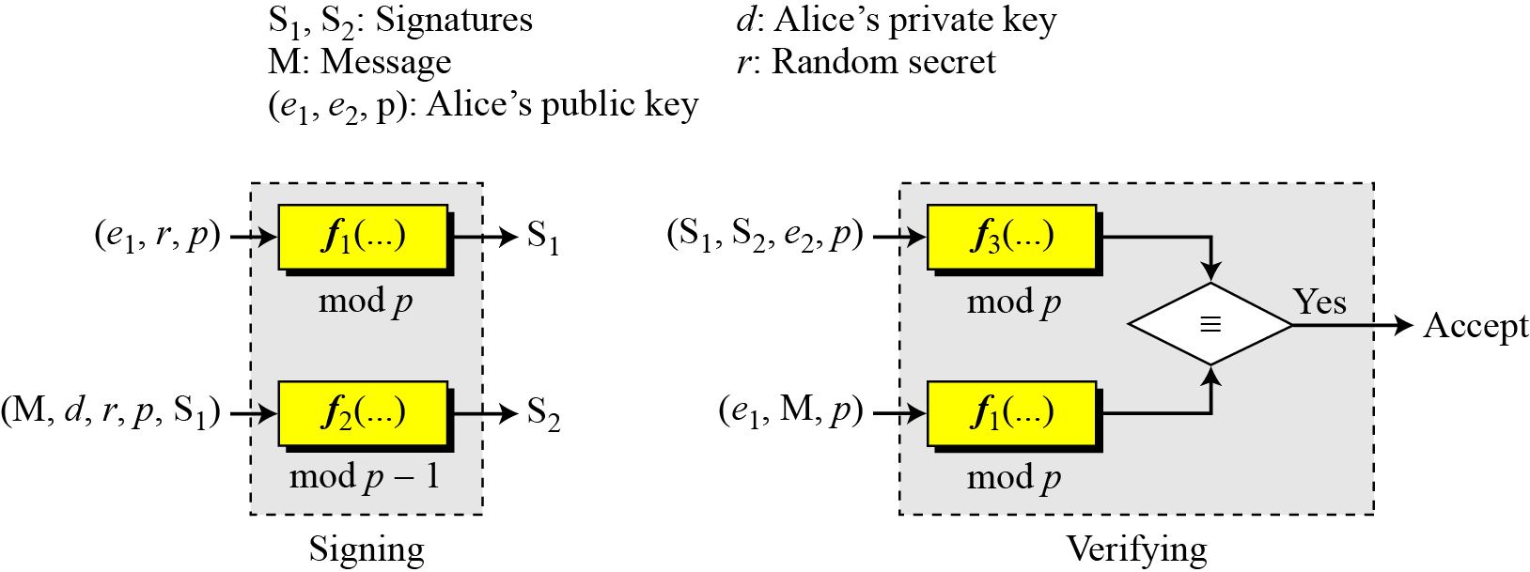
13.5.2 ElGamal Digital Signature Scheme
Figure 13.9 General idea behind the ElGamal digital signature scheme
13.<number>

Slide 28
13.5.2 Continued
Key Generation
The key generation procedure here is exactly the same as the one used in the cryptosystem.
Note
In ElGamal digital signature scheme, (e₁, e₂, p) is Alice’s public key; d is her private key.
13.<number>

Slide 29
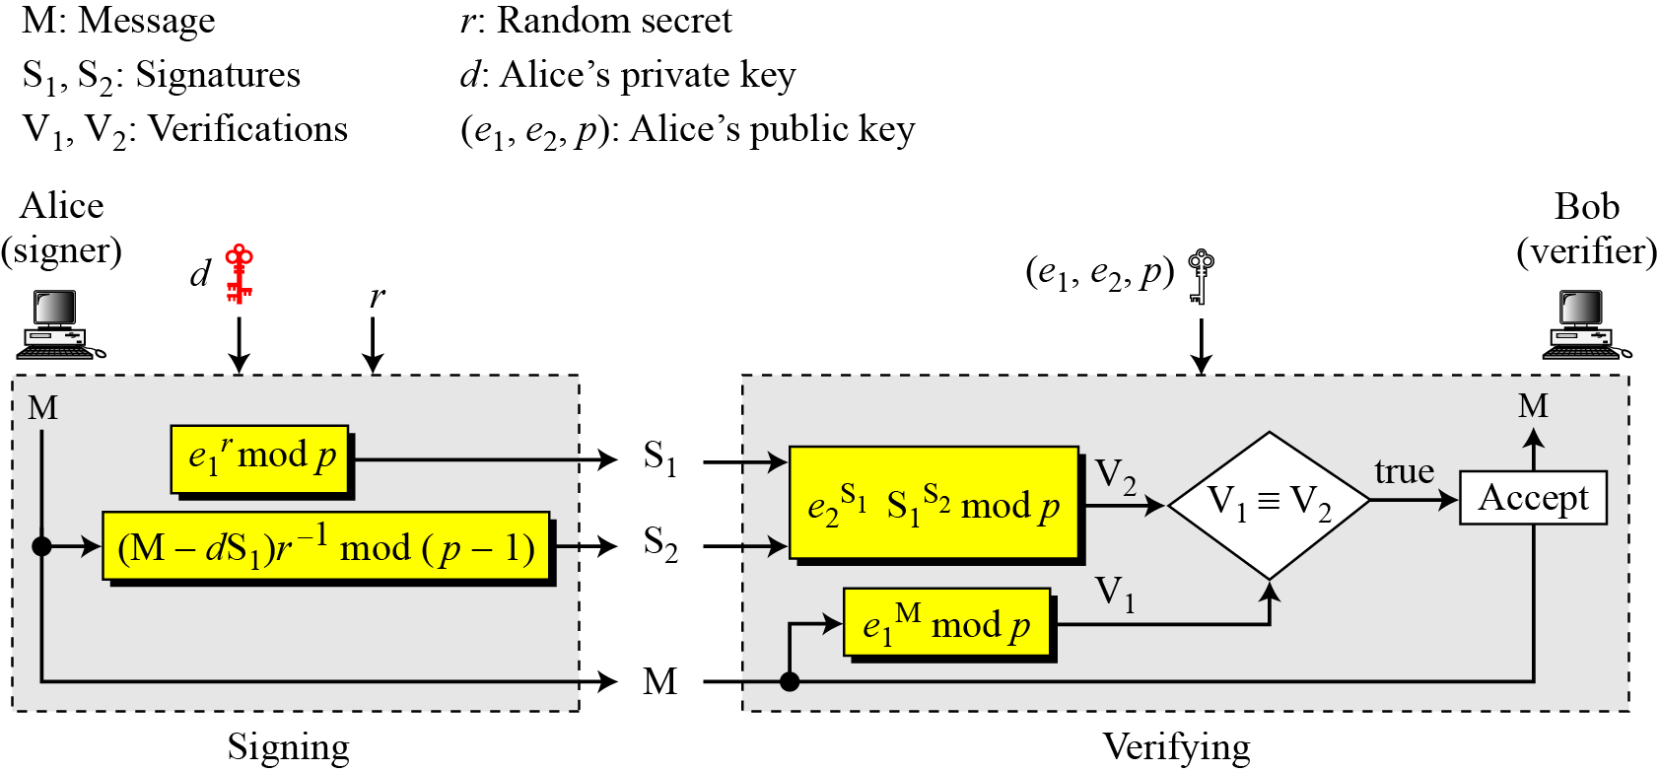
13.5.2 Continued
Verifying and Signing
Figure 13.10 ElGamal digital signature scheme
13.<number>

Slide 30
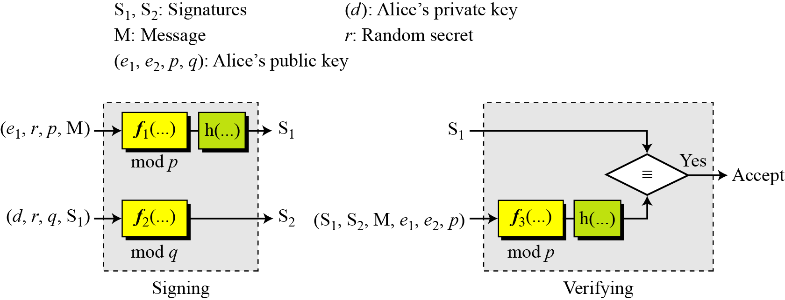
13.5.3 Schnorr Digital Signature Scheme
Figure 13.11 General idea behind the Schnorr digital signature scheme
13.<number>

Slide 31
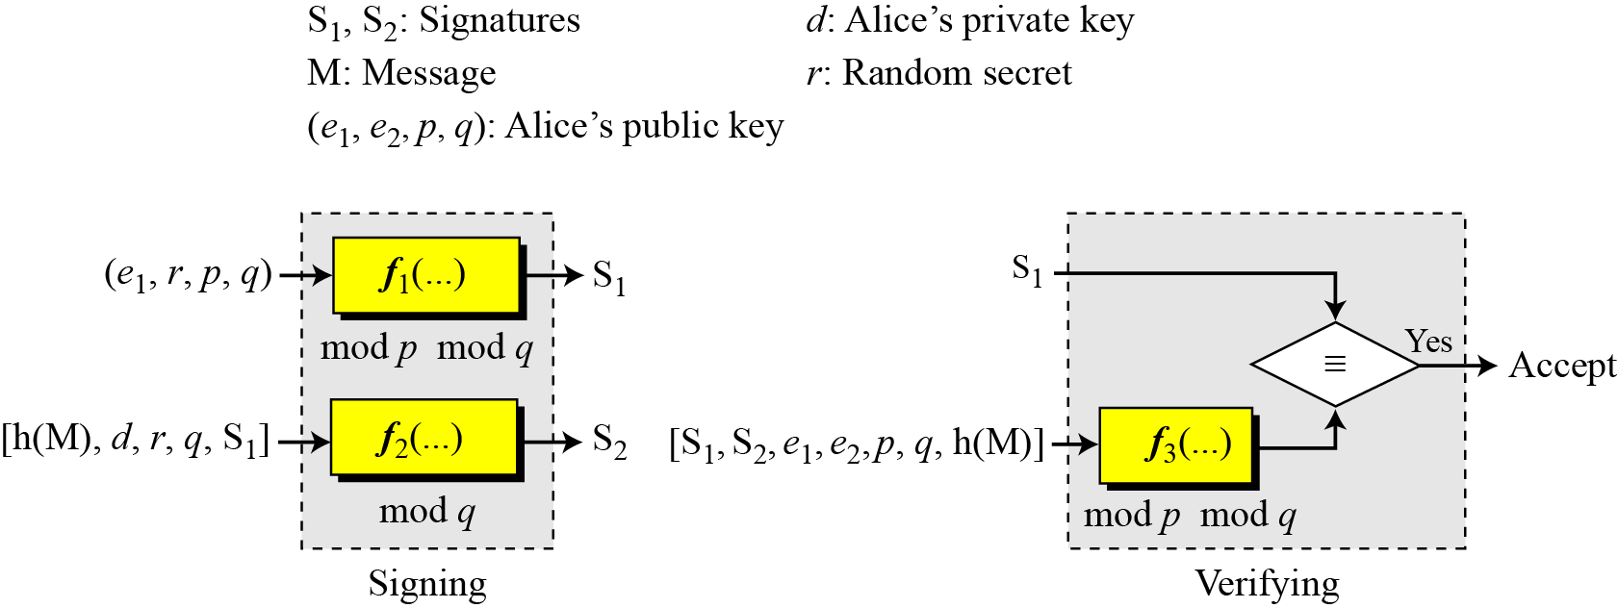
13.5.4 Digital Signature Standard (DSS)
Figure 13.13 General idea behind DSS scheme
13.<number>

Slide 32
13.5.4 Continued
DSS Versus RSA
Computation of DSS signatures is faster than computation of RSA signatures when using the same p.
DSS Versus ElGamal
DSS signatures are smaller than ElGamal signatures because q is smaller than p.
13.<number>

Slide 33
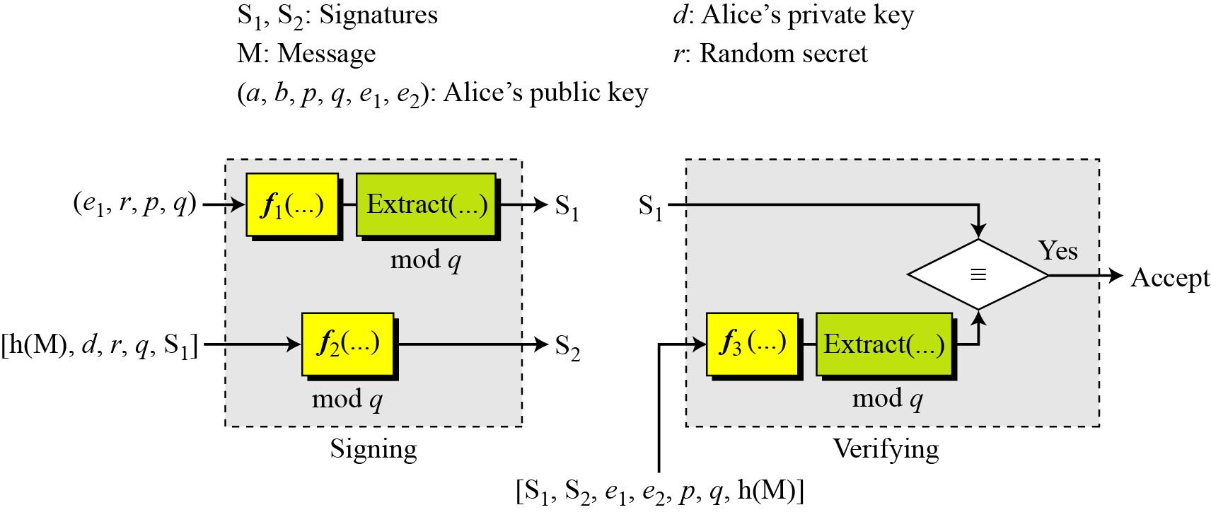
13.5.5 Elliptic Curve Digital Signature Scheme
Figure 13.15 General idea behind the ECDSS scheme
13.<number>

Slide 34
13-6 VARIATIONS AND APPLICATIONS
This section briefly discusses variations and applications for digital signatures.
Topics discussed in this section:
13.6.1 Variations
13.6.2 Applications
13.<number>

Slide 35
13.6.1 Variations
Time Stamped Signatures
Sometimes a signed document needs to be time stamped to prevent it from being replayed by an adversary. This is called time-stamped digital signature scheme.
Blind Signatures
Sometimes we have a document that we want to get signed without revealing the contents of the document to the signer.
13.<number>

